Slide 1
Chapter 3 Part I
Describing Syntax and Semantics

Slide 2
Chapter 3 Topics
Introduction
The General Problem of Describing Syntax
Formal Methods of Describing Syntax

Slide 3
Introduction
“In a well-designed programming language, semantics should follow directly from syntax; that is, the appearance of a statement should strongly suggest what the statement is meant to accomplish.”
Robert W. Sebesta
A = A + 1;
A + 1 ➔ A

Slide 4
Describing Syntax: Terminology
Language
Sentence
Lexeme – Token
Example: a = 2 * c + 3;
Lexemes Tokens
a identifier
= equal_sign
2 int_literal
* mult_op
c identifier
+ plus_op
3 int_literal
; semicolon
Recognizer
Generator

Slide 5
Backus-Naur Form (1959)
BNF is a meta-language for programming languages;
A description of the syntax rules of the languages
BNF Rule Examples
<ident_list> → identifier | identifier, <ident_list>
<if_stmt> → if <logic_expr> then <stmt>
<assign> -> <var> = <expression>
<stmt> → <single_stmt>
| begin <stmt_list> end
Note: Backus’ grammar similar to Chomsky’s Context-free and regulart grammars

Slide 6
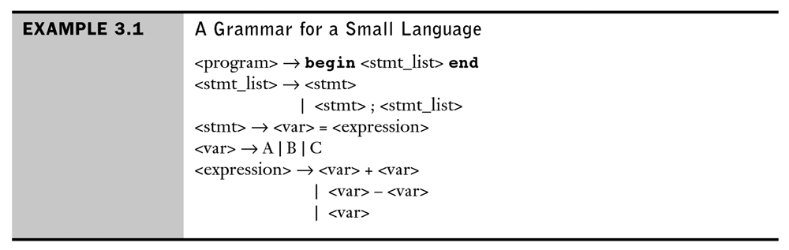

Slide 7
An example of a leftmost derivation of a program in the Small Language
<program> ➔ begin <stmt_list> end
➔ begin <stmt> ; <stmt_list> end
➔ begin <var> = <expression> ; <stmt_list> end
➔ begin A = <expression> ; <stmt_list> end
➔ begin A = <var> + <var> ; <stmt_list> end
➔ begin A = B + <var> ; <stmt_list> end
➔ begin A = B + C ; <stmt_list> end
➔ begin A = B + C ; <stmt> end
➔ begin A = B + C ; <var>= <expression> end
➔ begin A = B + C ; B = <expression> end
➔ begin A = B + C ; B = <var> end
➔ begin A = B + C ; B = C end

Slide 8
BNF Grammar Example 3.2 for a Simple Assignment Statement and example derivation
<assign> → <id> = <expr>
<id> → A | B | C
<expr> → <id> + <expr>
| <id> * <expr>
| ( <expr> )
| <id>
An example leftmost derivation of this grammar:
<assign> ➔ <id> = <expr>
. ➔ A = <expr>
. ➔ A = <id> * <expr>
. ➔ A = B * <expr>
. ➔ A = B * ( <expr> )
. ➔ A = B * ( <id> + <expr> )
. ➔ A = B * ( A + <expr> )
. ➔ A = B * ( A + <id> )
. ➔ A = B * ( A + C )

Slide 9
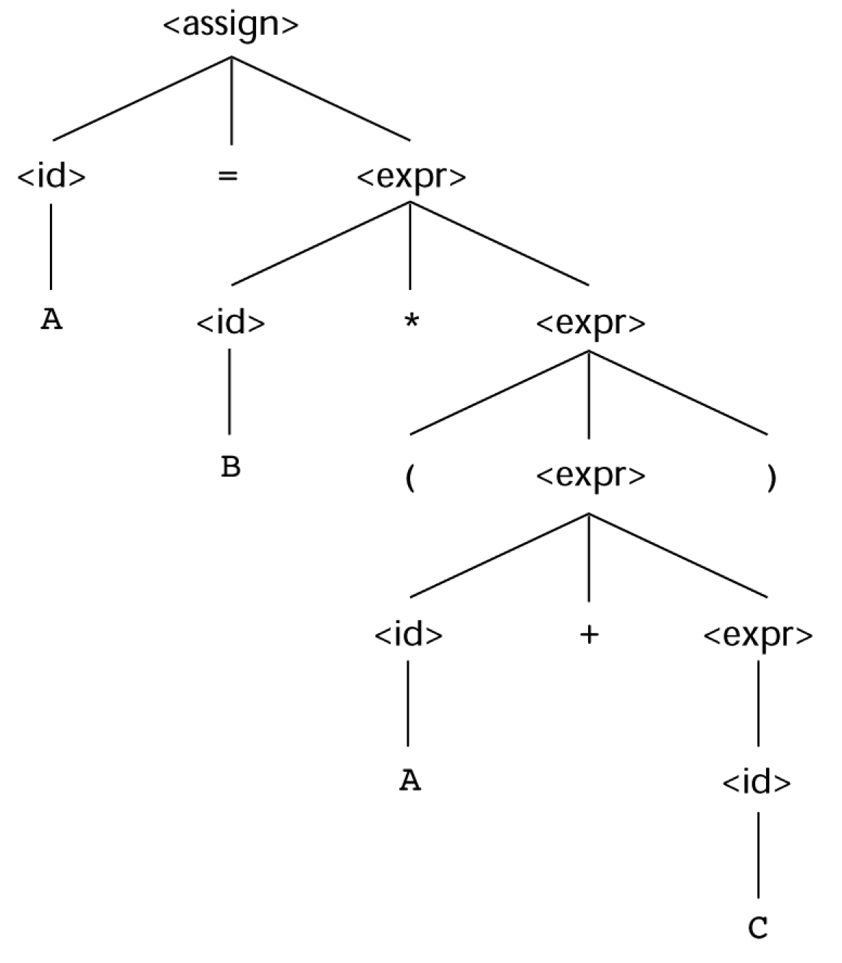
Figure 3.1
A parse tree for the simple statement A = B * (A + C)

Slide 10
An Example Grammar
<program> → <stmts>
<stmts> → <stmt> | <stmt> ; <stmts>
<stmt> → <var> = <expr>
<var> → a | b | c | d
<expr> → <term> + <term> | <term> - <term>
<term> → <var> | const
An Example Derivation

Slide 11
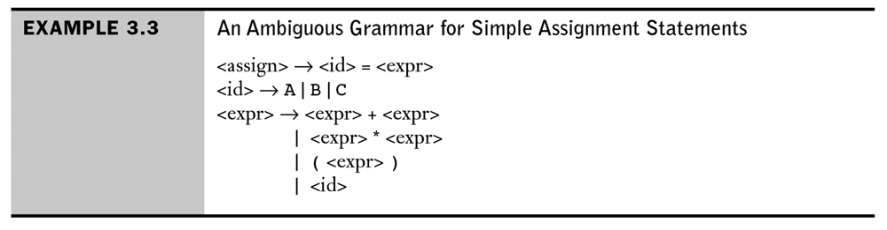
Ambiguity
A grammar is ambiguous if it can produce two distinct parse trees for the same expression
Compare to Example 3.2 which is not ambiguous:
<assign> → <id> = <expr>
<id> → A | B | C
<expr> → <id> + <expr>
| <id> * <expr>
| ( <expr> )
| <id>

Slide 12
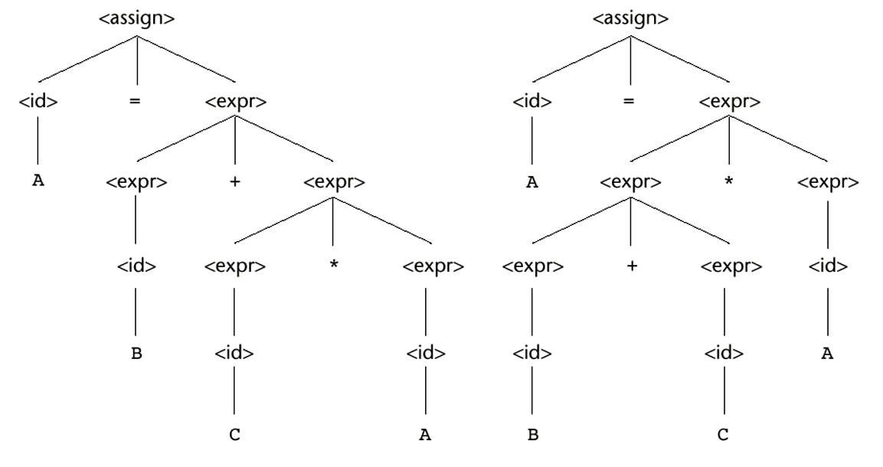
Ambiguous Grammars
Figure 3.2
Two distinct parse trees for the same sentence, A = B + C * A

Slide 13
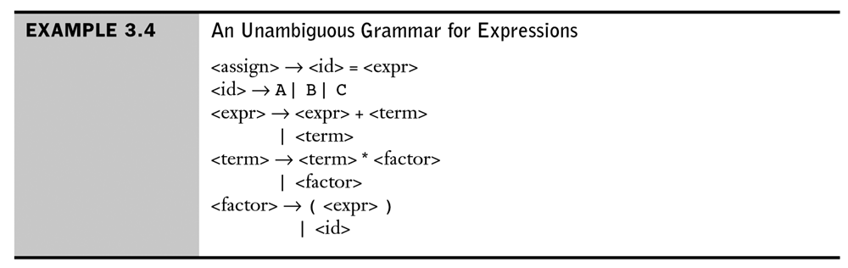
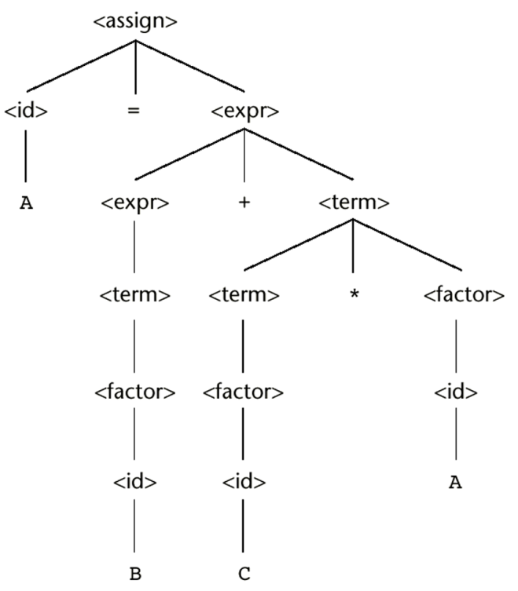
Unambiguous with consistent precedence
Compare to Example 3.2 which is not ambiguous but does not enforce precedence.
<assign> → <id> = <expr>
<id> → A | B | C
<expr> → <id> + <expr>
| <id> * <expr>
| ( <expr> )
| <id>
Parse tree for:
A = B + C * A
Note that rightmost and leftmost derivations produce the same parse tree.

Slide 14
An Unambiguous Expression Grammar
If we use the parse tree to indicate precedence levels of the operators, we cannot have ambiguity
<expr> → <expr> - <term> | <term>
<term> → <term> / const| const
<expr>
<expr>
-
<term>
<term>
<term>
/
const
const
const

Slide 15
Associativity of Operators
Operator associativity can also be indicated by a grammar
<expr> -> <expr> + <expr> | const (ambiguous)
<expr> -> <expr> + const | const (unambiguous)
<expr>
<expr>
<expr>
+
const
<expr>
+
const
const

Slide 16
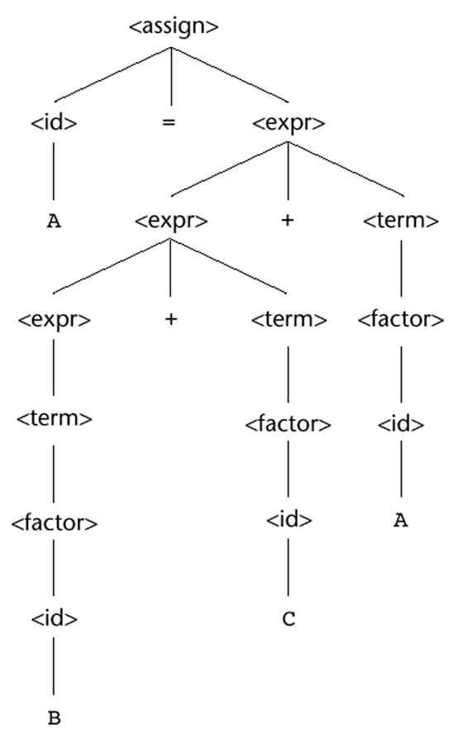
Associativity of Operators
A = B + C + A and Grammar 3.4
For right associativity:
<factor> → <exp> ** <factor>
| <exp>
<exp> → ( <expr> ) | id
…

Slide 17
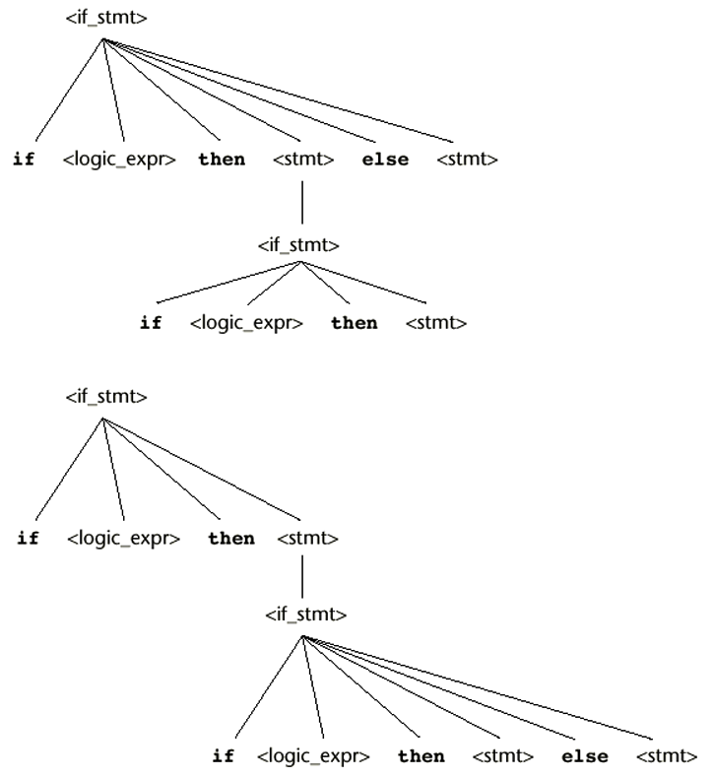
Figure 3.5 extra
<stmt> → <if_stmt>
<if stmt> → if <logic_expr> then <stmt>
| if <logic_expr> then <stmt> else <stmt>
Consider the sentential form:
if <logic_expr> then if <logic_expr> then <stmt> else <stmt>
Yields two distinct parse trees (seel right) and is therefore ambiguous
Consider:
if (done == true)
then if (denom == 0)
then quotient = 0;
else quotient = num / denom;
Problem: If the upper parse tree is used, then the outermost if will be associated with the else.

Slide 18
Unambiguous Grammar for the If Statement
Revised Grammar
<stmt> → <matched> | <unmatched>
<matched> → if <logic_expr> then <matched> else<matched>
| any non-if statement
<unmatched> → if <logic_expr> then <stmt>
| if <logic_expre> then <matched>
else <unmatched>
Now just one possible parse tree for the following
if <logc_expr> then if <logic_expr> then <stmt> else <stmt>

Slide 19
EBNF
Extended Backus-Naur Form
Uses Metasymbols [], {}, | to make the notation more concise.
Optional RHS denoted by brackets []
<selection> → if (<expression>) <stmt> [else <stmt>]
Zero or more repetitions denoted by braces {}
<ident_list> → <ident> { , <ident> }
Choice of a single element from a group denoted by placing options in parentheses and separated by |
<term> → <term> ( * | / | % ) <factor>
Example 3.5 on page 133 (see next slide)

Slide 20
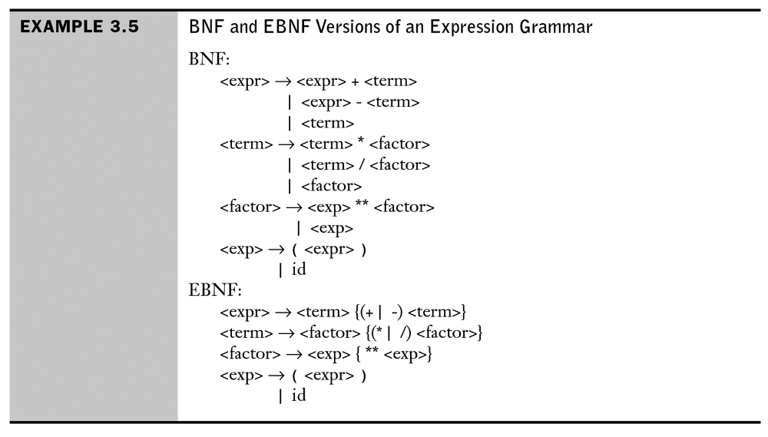

Slide 21
BNF and EBNF
BNF
<expr> → <expr> + <term>
| <expr> - <term>
| <term>
<term> → <term> * <factor>
| <term> / <factor>
| <factor>
EBNF
<expr> → <term> {(+ | -) <term>}
<term> → <factor> {(* | /) <factor>}

Slide 22
Recent Variations in EBNF
Alternative RHSs are put on separate lines
Use of a colon instead of =>
Use of _{opt} for optional parts
Use of oneof for choices

Slide 23
Syntax Diagrams
Syntax Diagrams (graphs) are used to represent the entire syntactic structure of a parse.
Also used to represent the syntax of a single rule.
Example: see next slide

Slide 24
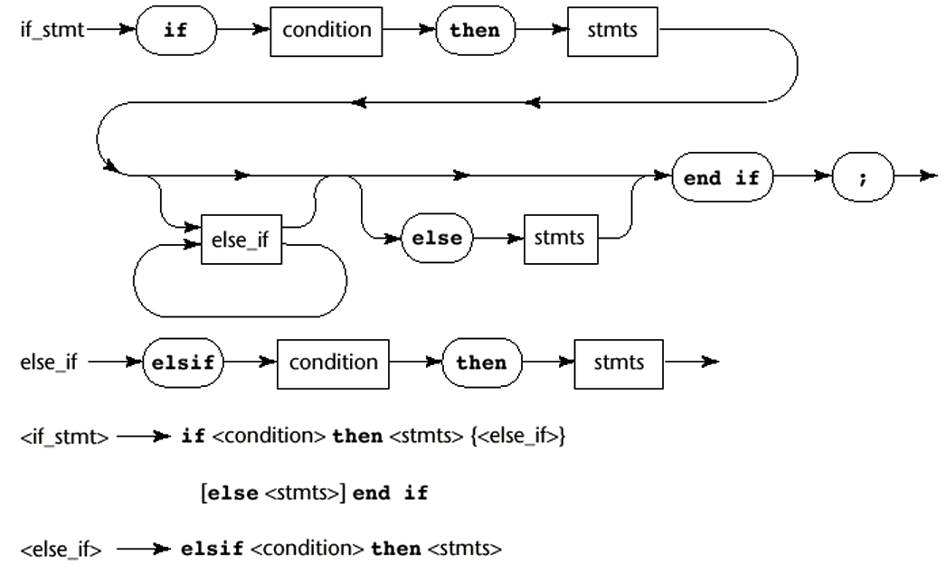
The syntax diagram (graph) and EBNF descriptions of the Ada if statement

Slide 25
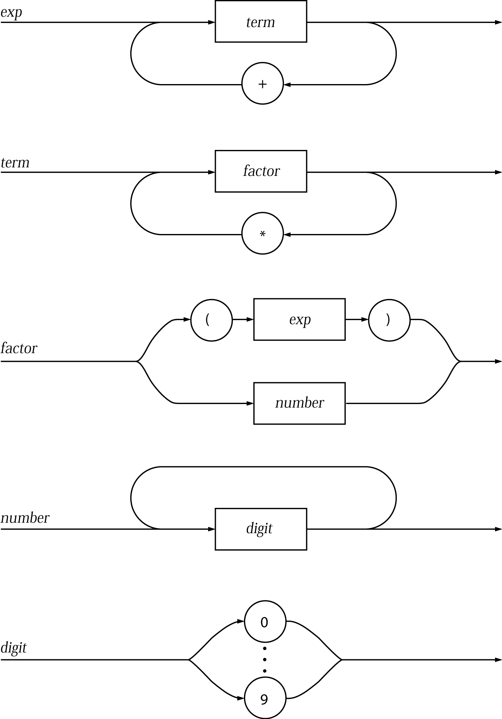
More Examples of Syntax Diagrams from Programming Languages Principles and Practice, 2nd ed Kenneth C. Louden Thompson Brooks/Cole ISBN: 0534953417
© 2003 Brooks/Cole - Thomson Learning™

Slide 26
Grammar/Recognizer Connection
Given a context-free grammar for a language, a recognizer (syntax analyzer) can be constructed.
One of the first is yacc

